Slide 1
GENERATIVE MODELS
An Introduction to Autoencoders and GANs
ML TALK
By Yash Sahijwani

Slide 2
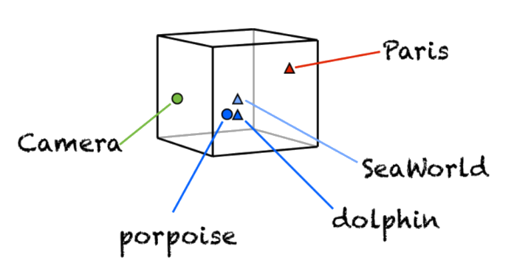
WHY ARE AUTOENCODERS USED?
Representation learning
Unlabelled Data
Can be used in variety of ML and DL areas
Can also be used for dimensionality reduction

Slide 3
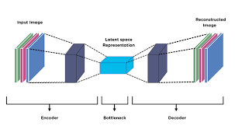
WHAT ARE AUTOENCODERS?
Neural Networks for Representation Learning
Usage of Bottleneck
Framing Representation learning as a supervised learning problem
Reconstruction loss as loss function

Slide 4
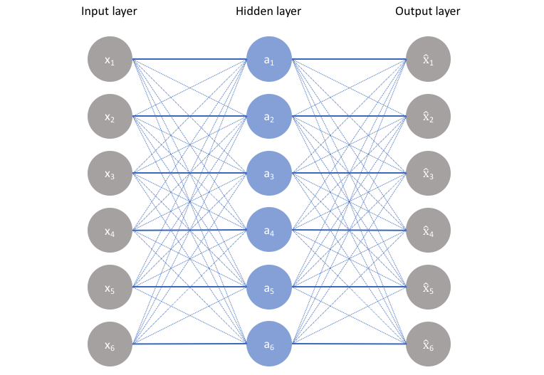
NEED FOR BOTTLENECK
NEED A REGULARIZER TO AVOID THIS

Slide 5
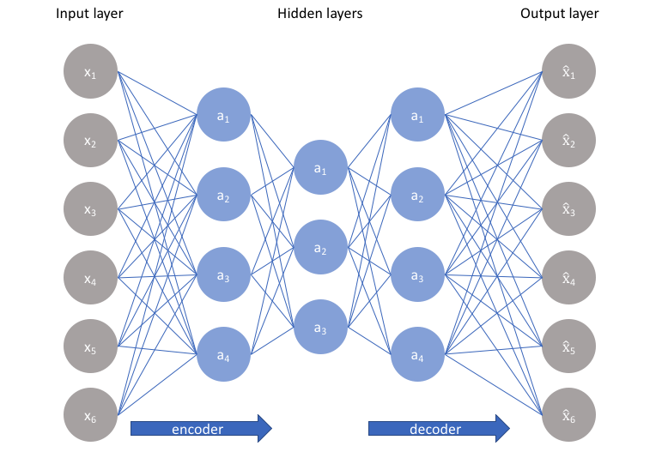
undercomplete AUTOENCODER
Simple Encoder Decoder Architecture
Constraining the number of nodes
No explicit regularizer
Problem may arise with deep or large
capacity Neural Networks

Slide 6
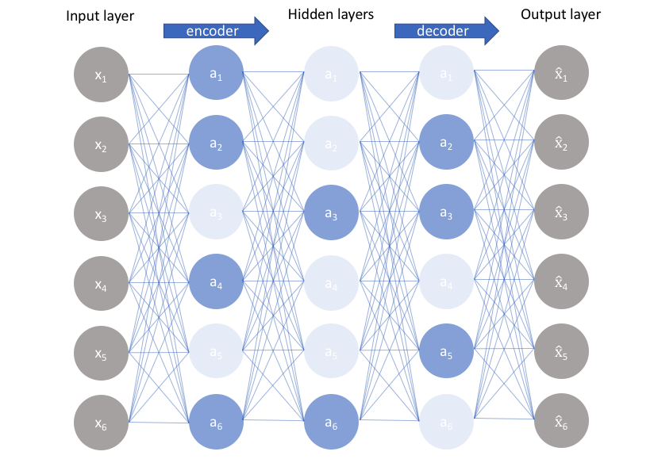
SPARSE AUTOENCODER
Bottleneck without constraining the number of nodes
Penalizing activations of nodes within a layer
Not the regularization of weights
Encoded state depends on a few activated
neurons
The activated neurons change with change
in input

Slide 7
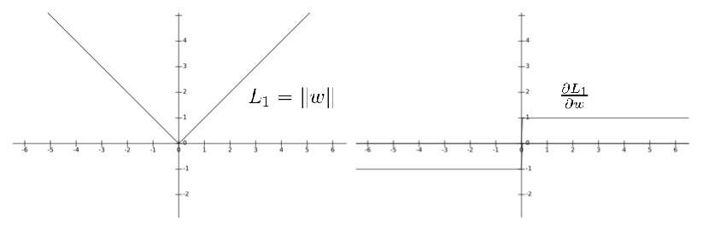
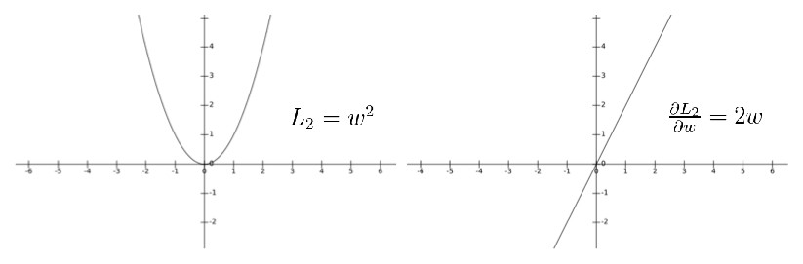
Regularizers in SAE
L1 REGULARIZATION
L2 REGULARIZATION

Slide 8
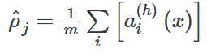
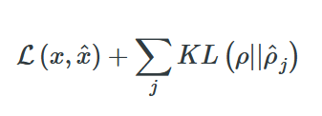
REGULARIZERS IN SAE
KL DIVERGENCE
Use a sparsity parameter

Slide 9
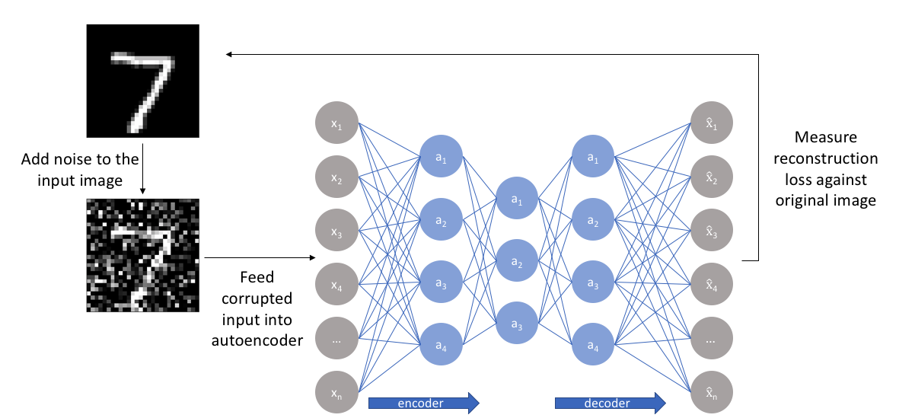
DENOISING AUTOENCODERS
Learn Representation of slightly corrupted data
Build or reconstruct uncorrupted data

Slide 10
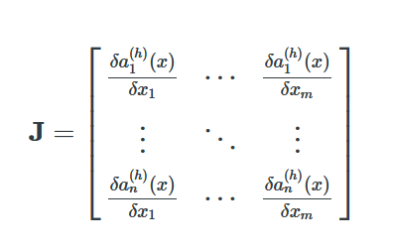
CONTRACTIVE AUTOENCODERS
Very similar inputs have very similar representations
Penalizing derivatives of activations of the nodes of the hidden layer
Little perturbations – don’t have effect

Slide 11
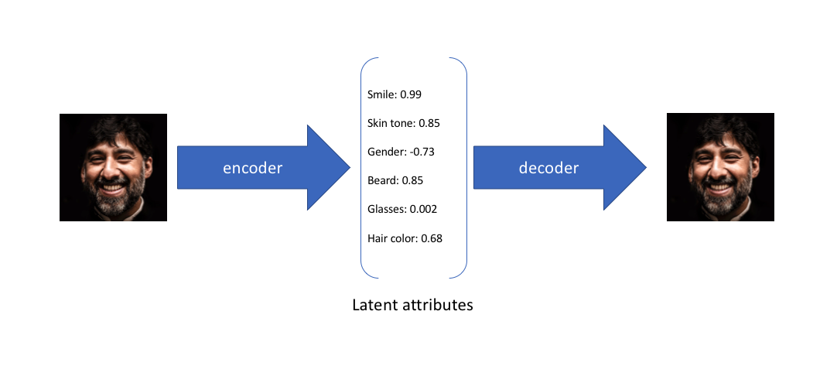
VARIATIONAL AUTOENCODERS
Instead of learning a fixed value representation
A probabilistic distribution is learned

Slide 12
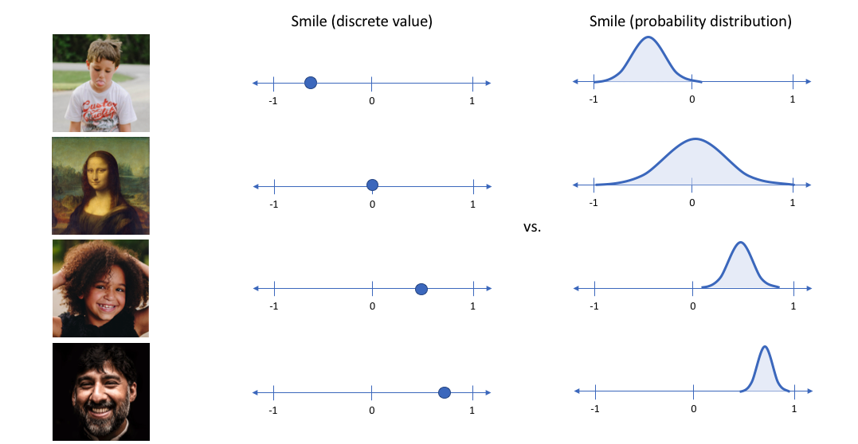
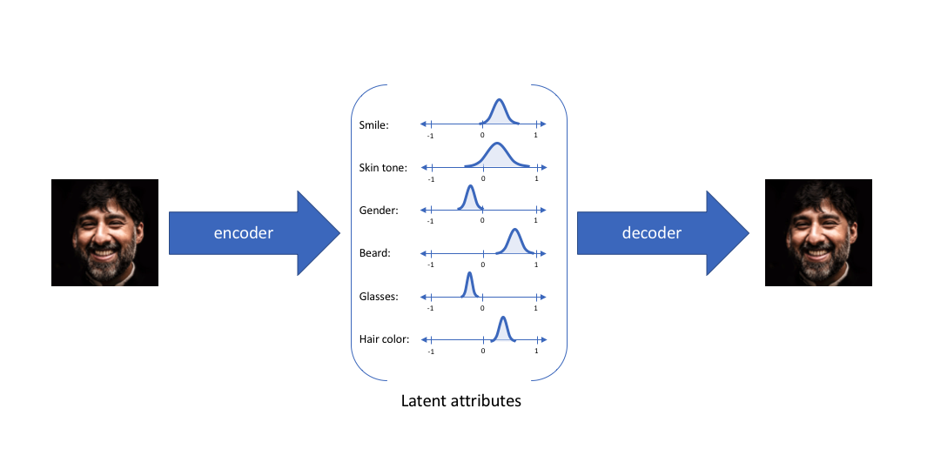

Slide 13
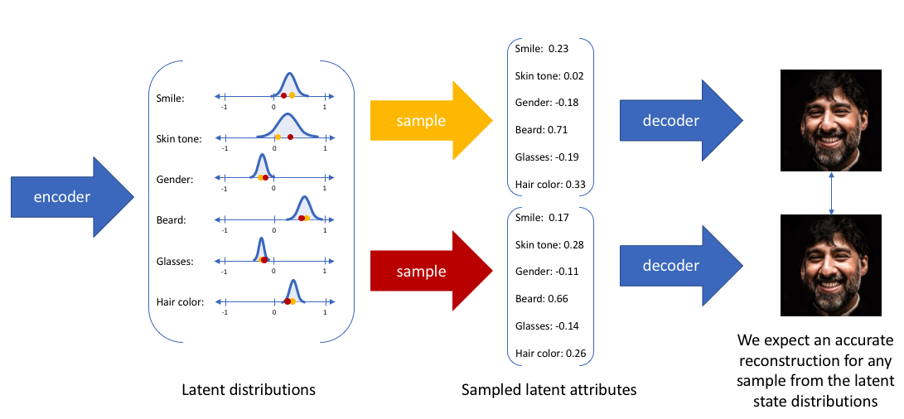

Slide 14
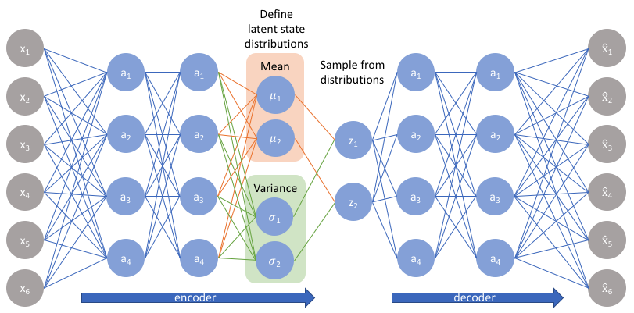
Assume that the distributions are gaussian and hence can be represented through the mean and variance
No covariance or correlation coefficient

Slide 15
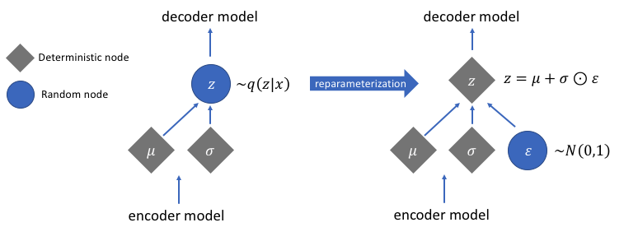
REPARAMETERIZATION

Slide 16
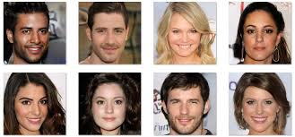
GANs – GENERATIVE ADVERSARIAL NETWORKS
Generative Models
Can be used to produce “fake data” which looks very much like real data😁😁

Slide 17
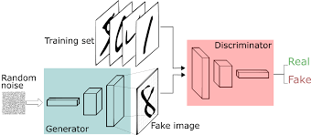
Consists of two networks – a generator and a discriminator
Generator tries to generate data which is very similar to real data
Discriminator tries to differentiate between real data and the data generated by the generator

Slide 18
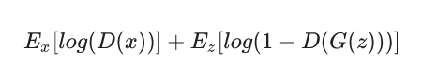
Keep Generator fixed.
Train discriminator to find the difference between real and fake data
After some epochs, keep the discriminator fixed and train the generator so that it mistakes the fake data to be real data
Convergence occurs when the discriminator has a 50% accuracy.

Slide 19
THANK YOU

